Slide 1

Extension Work in Recent Disasters
USDA-NIFA

Slide 2
Texas Wildfires

Slide 3
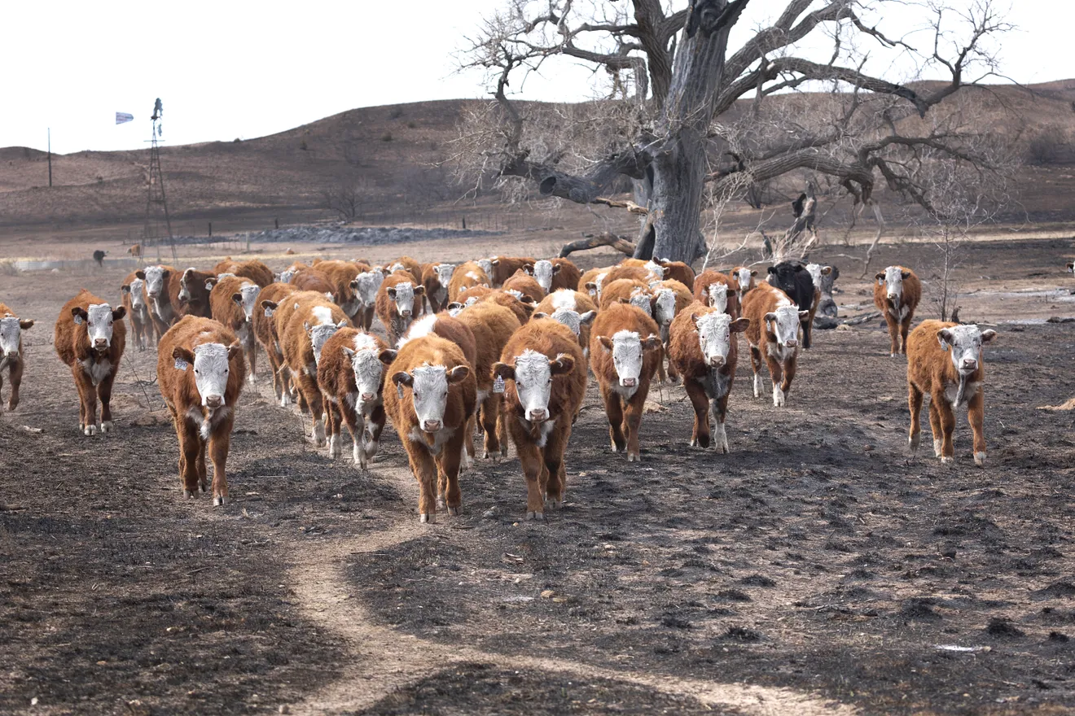
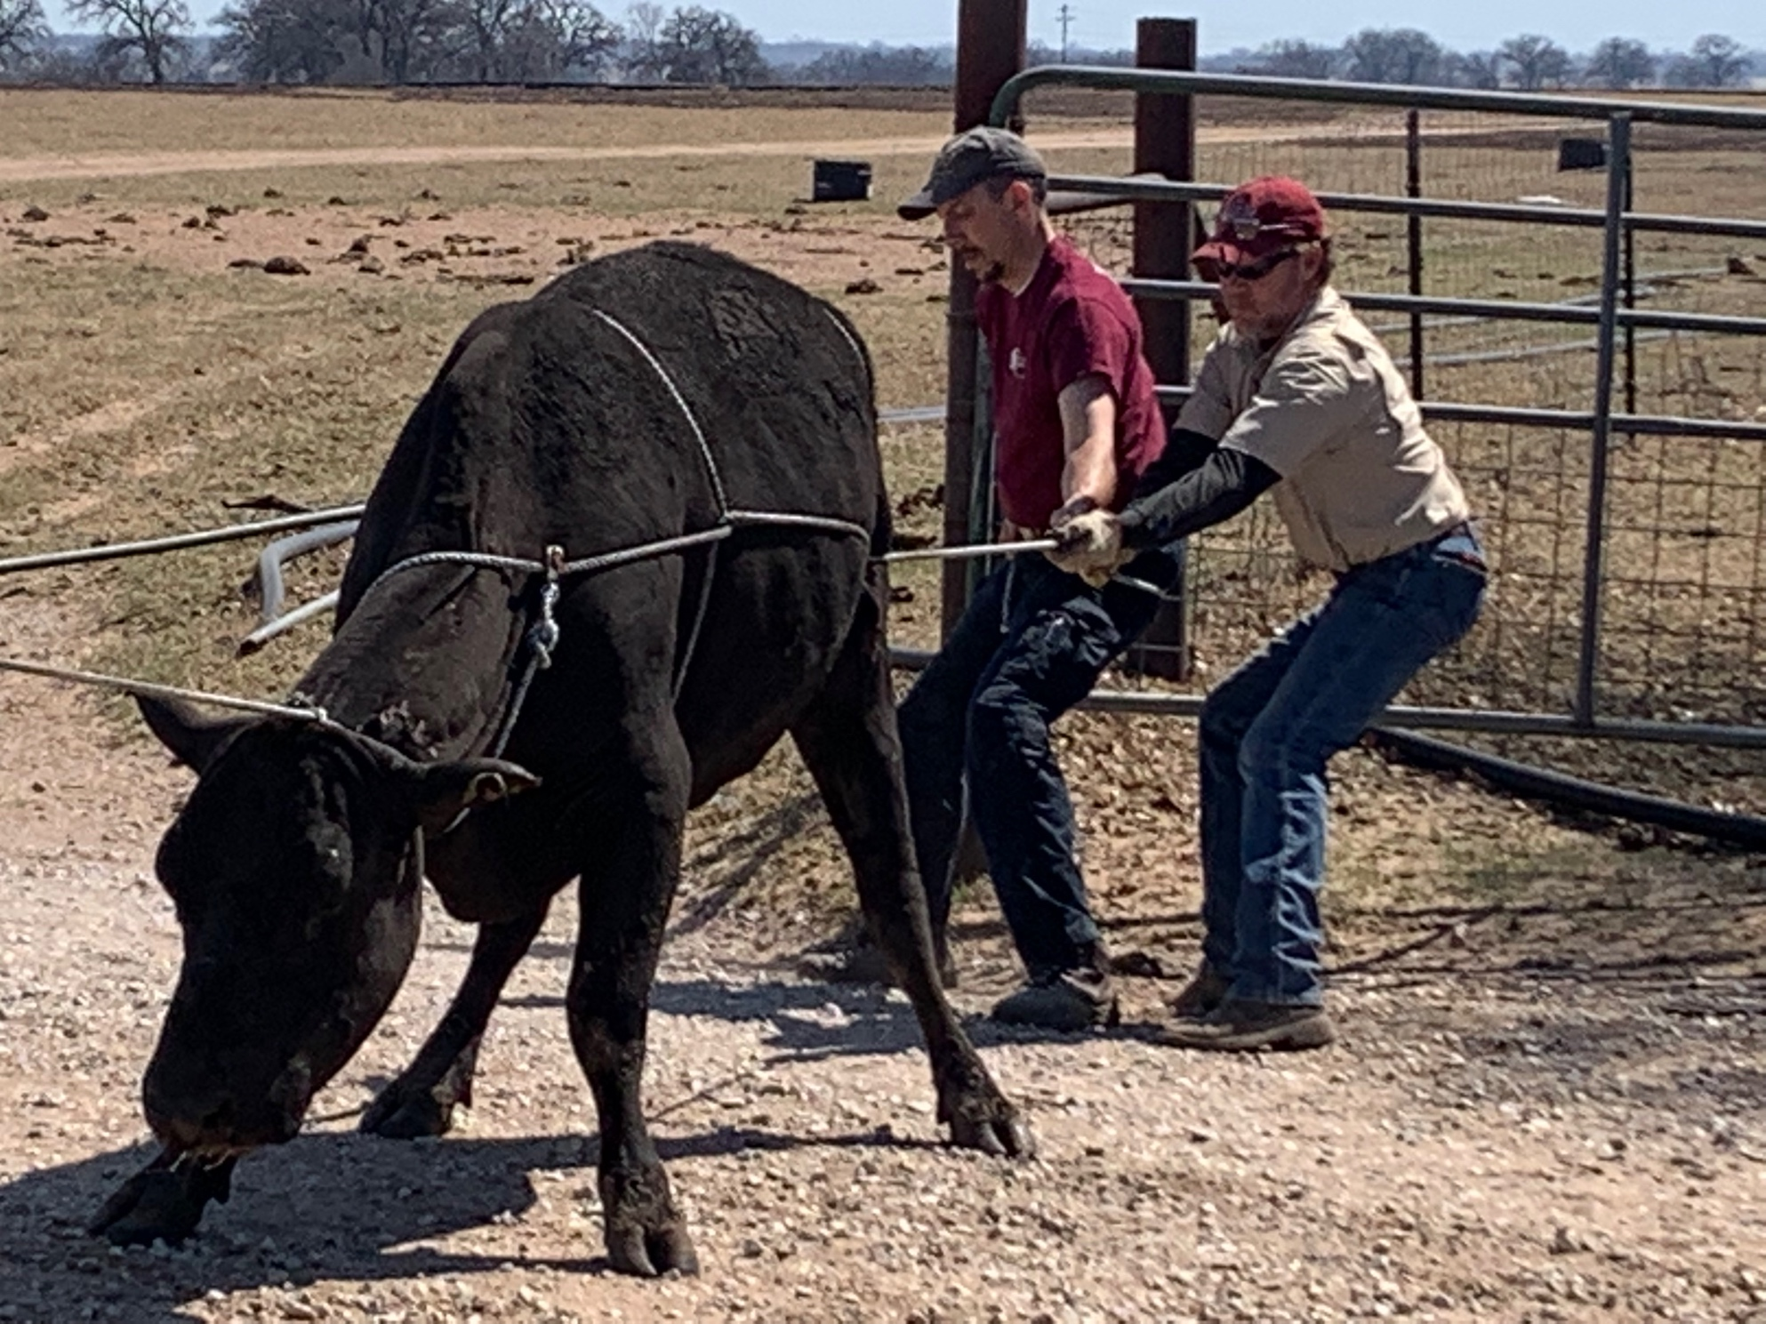

Slide 4
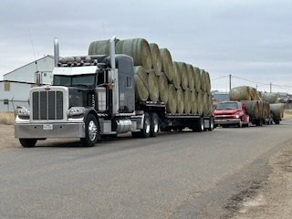
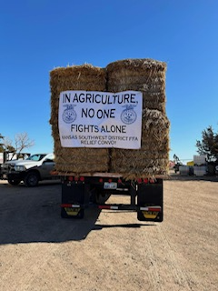

Slide 5
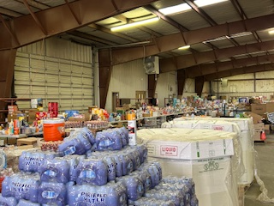
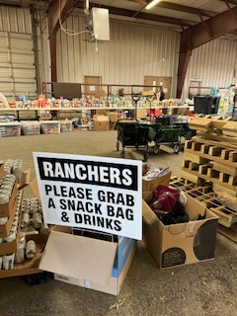

Slide 6
Hurricane Helene
September 26-29
Georgia, North Carolina, & Florida
Impacts & Examples of
Extension’s Response

Slide 7
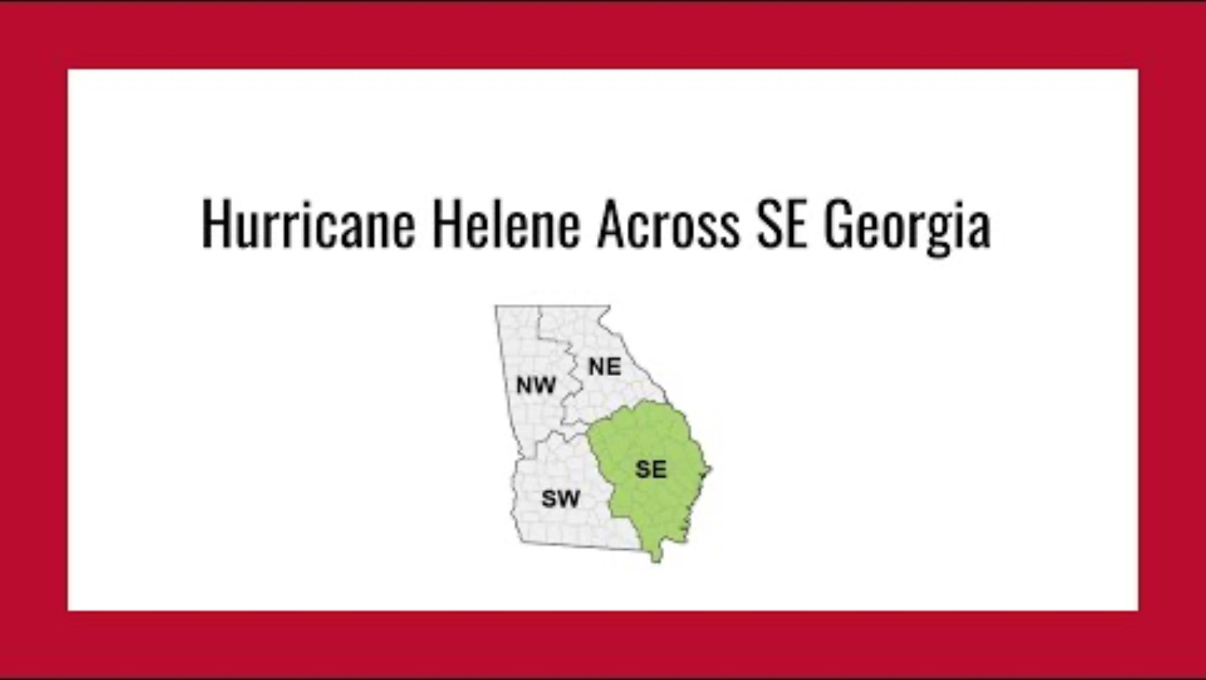
https://youtu.be/AR6v8IjGHwI?si=4T01DgFobL-3580_
Georgia

Slide 8
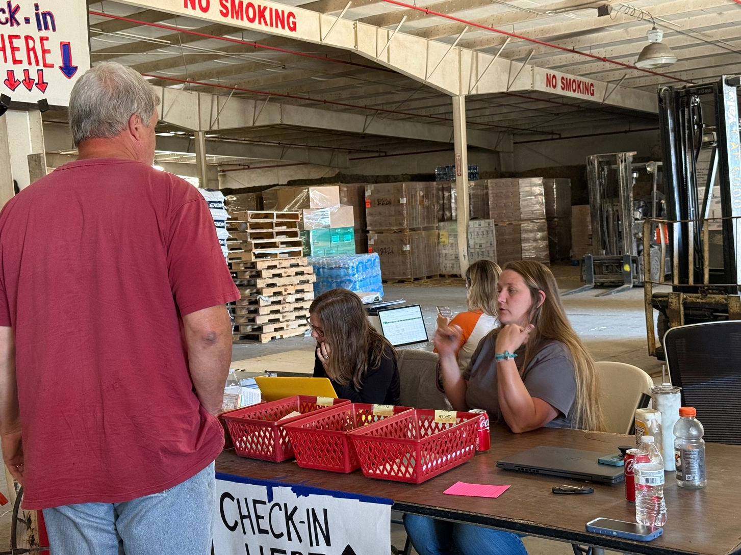
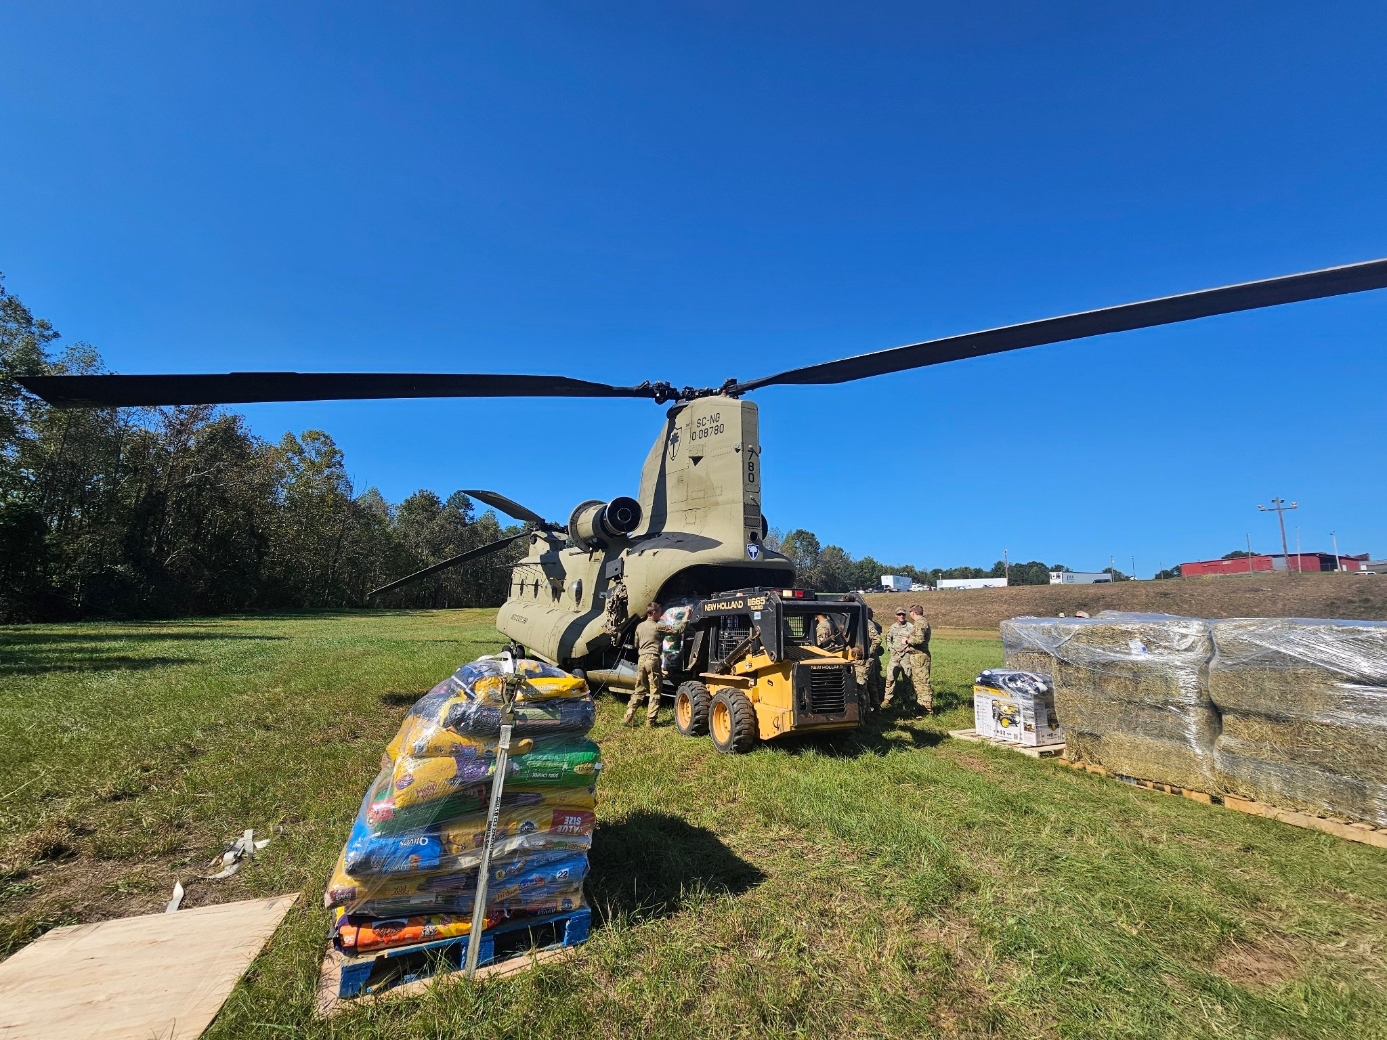
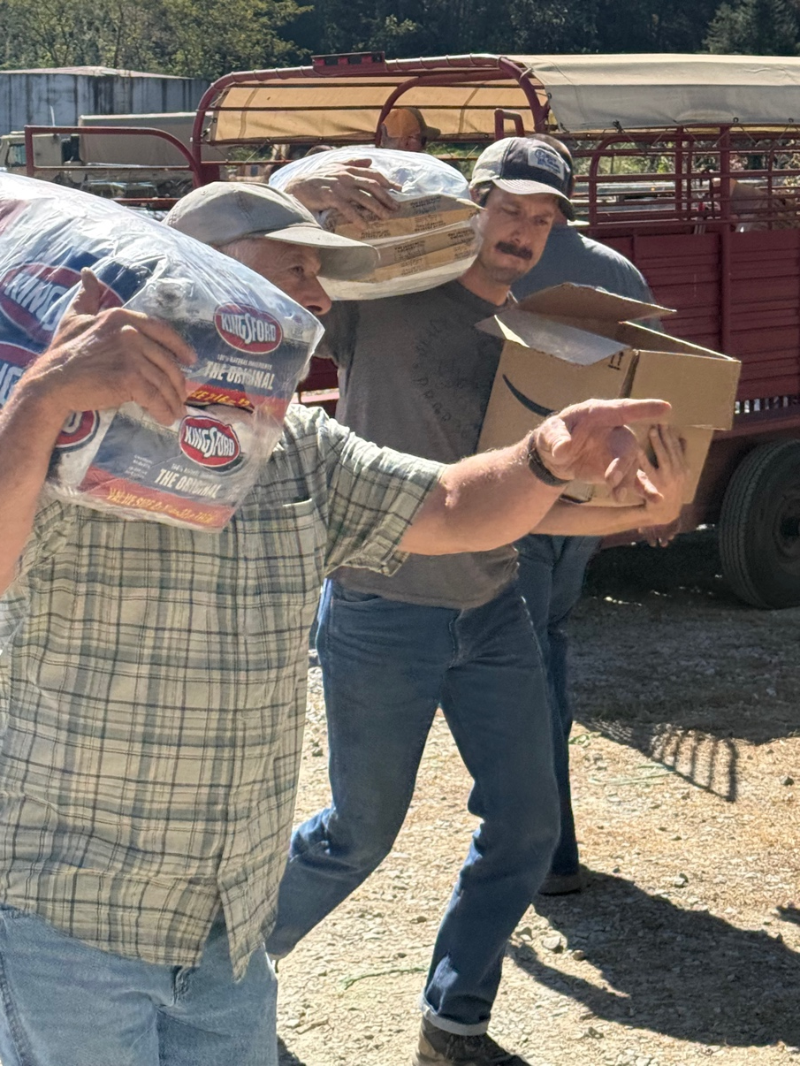
North Carolina

Slide 9
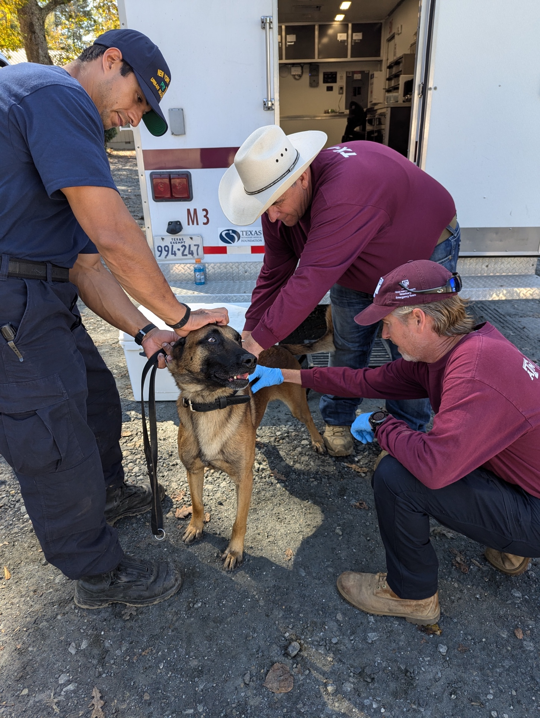
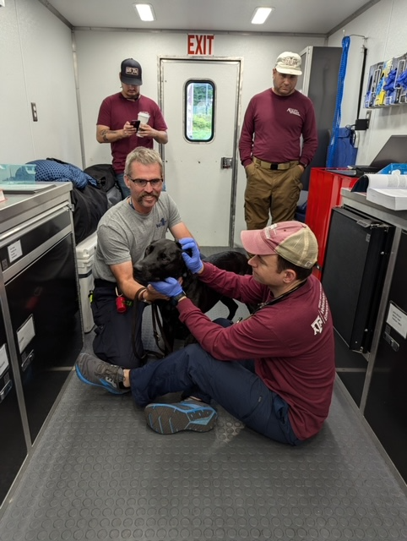
North Carolina

Slide 10
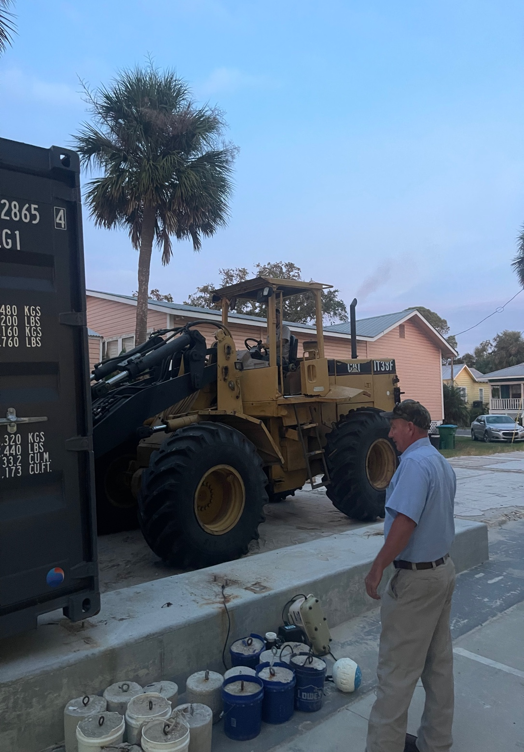
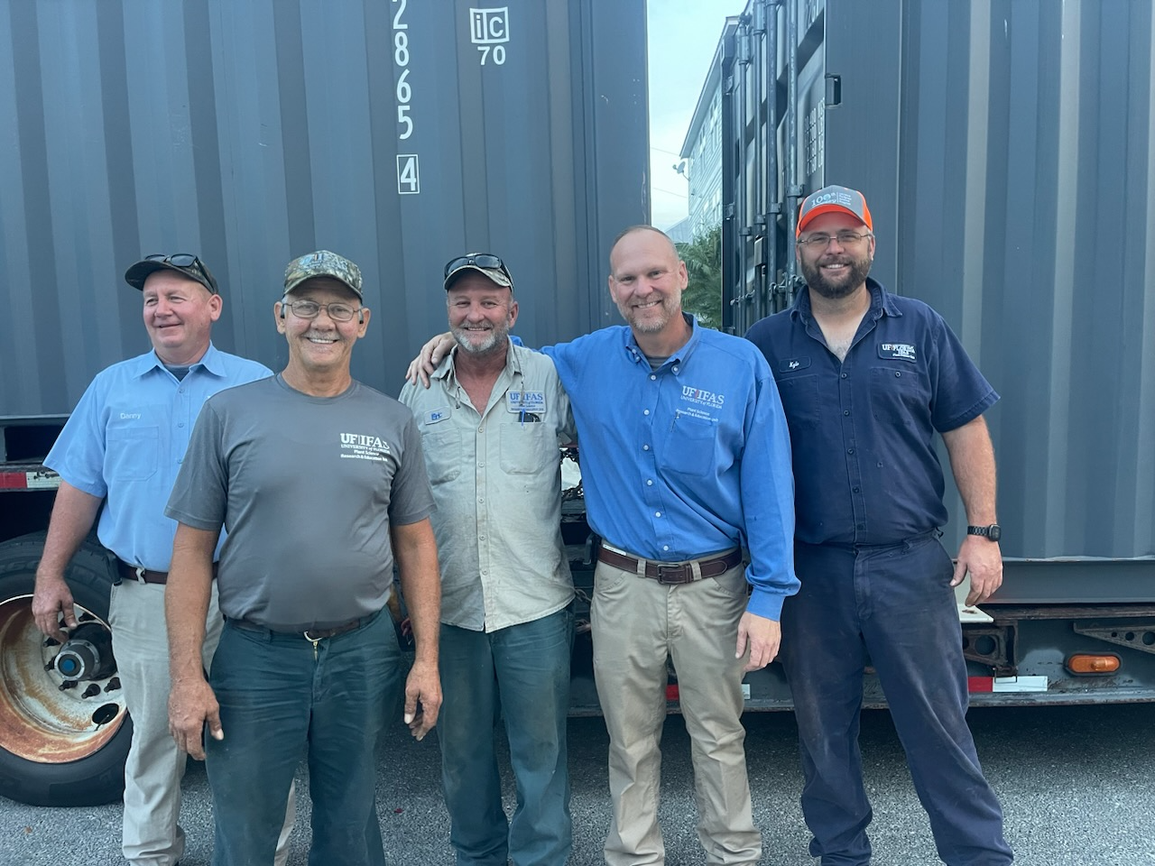
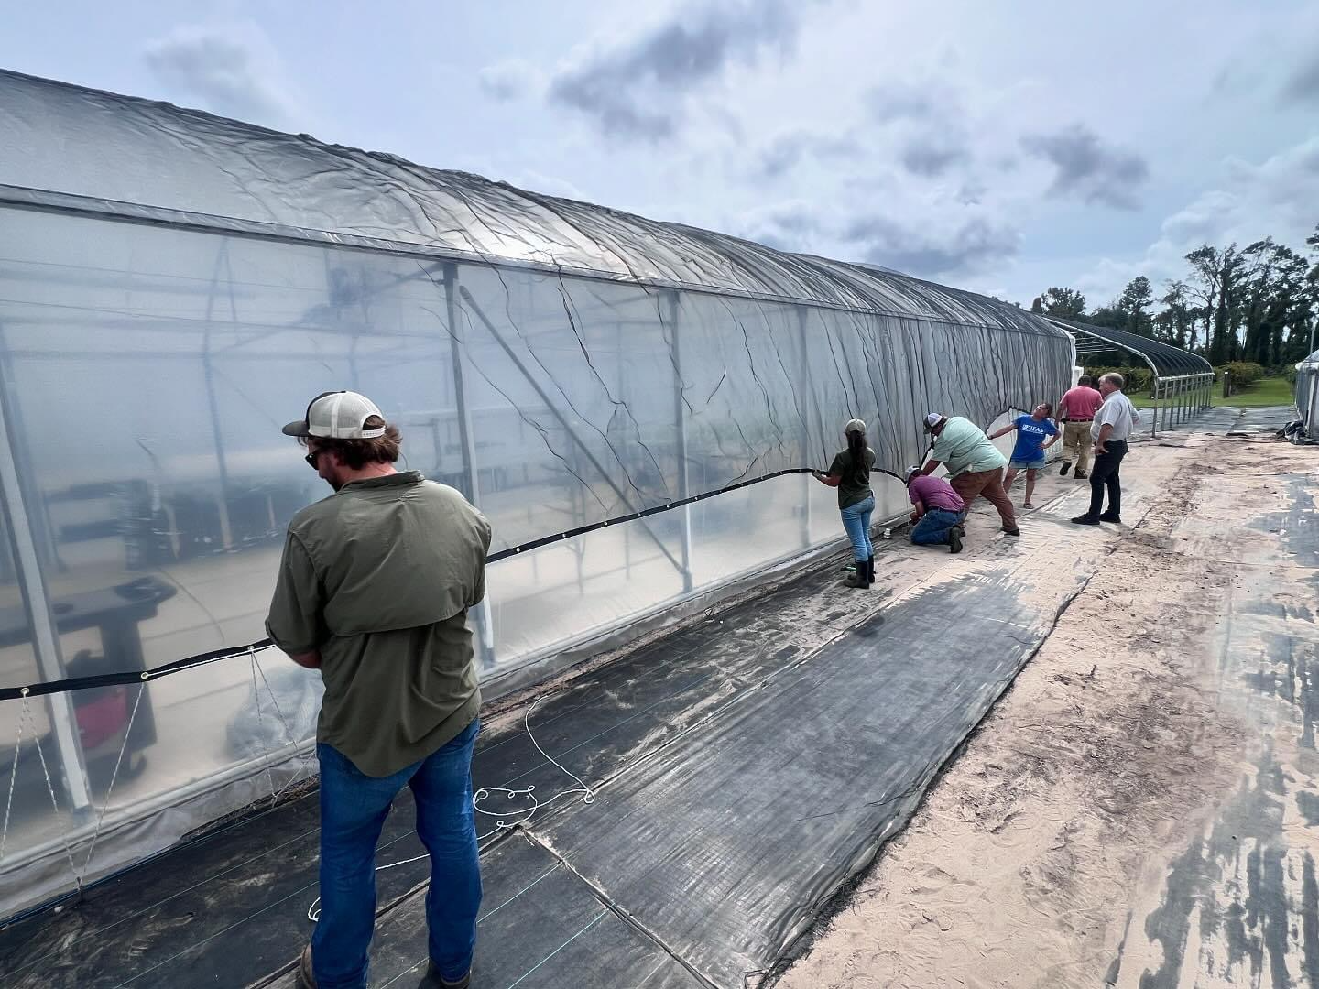
Pre-Storm Prep
Florida

Slide 11
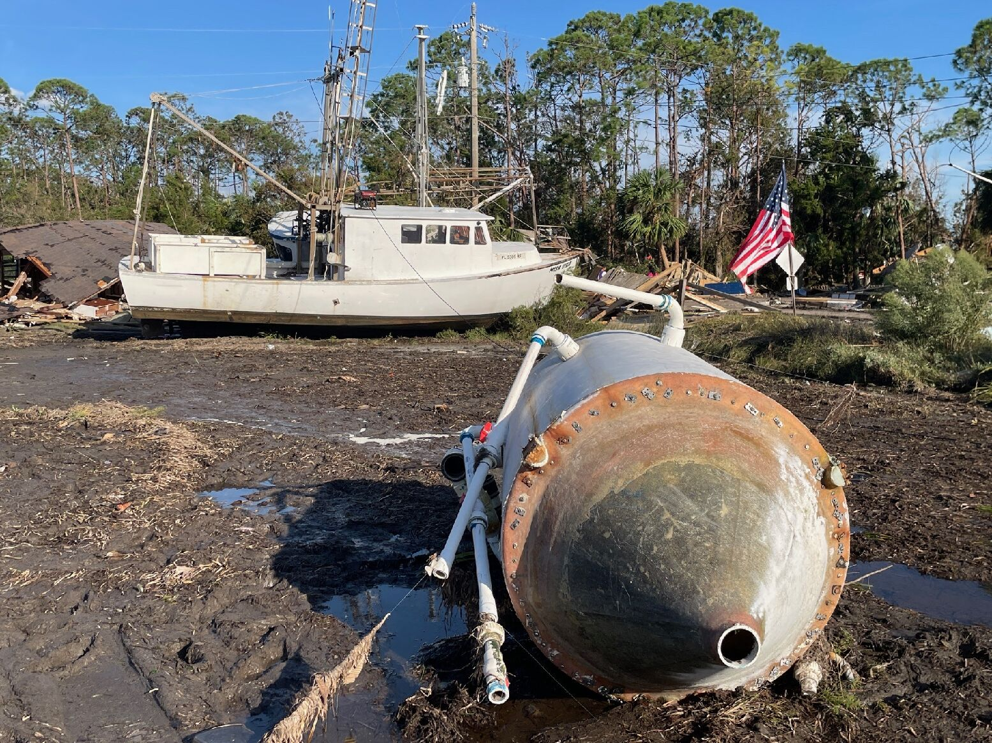
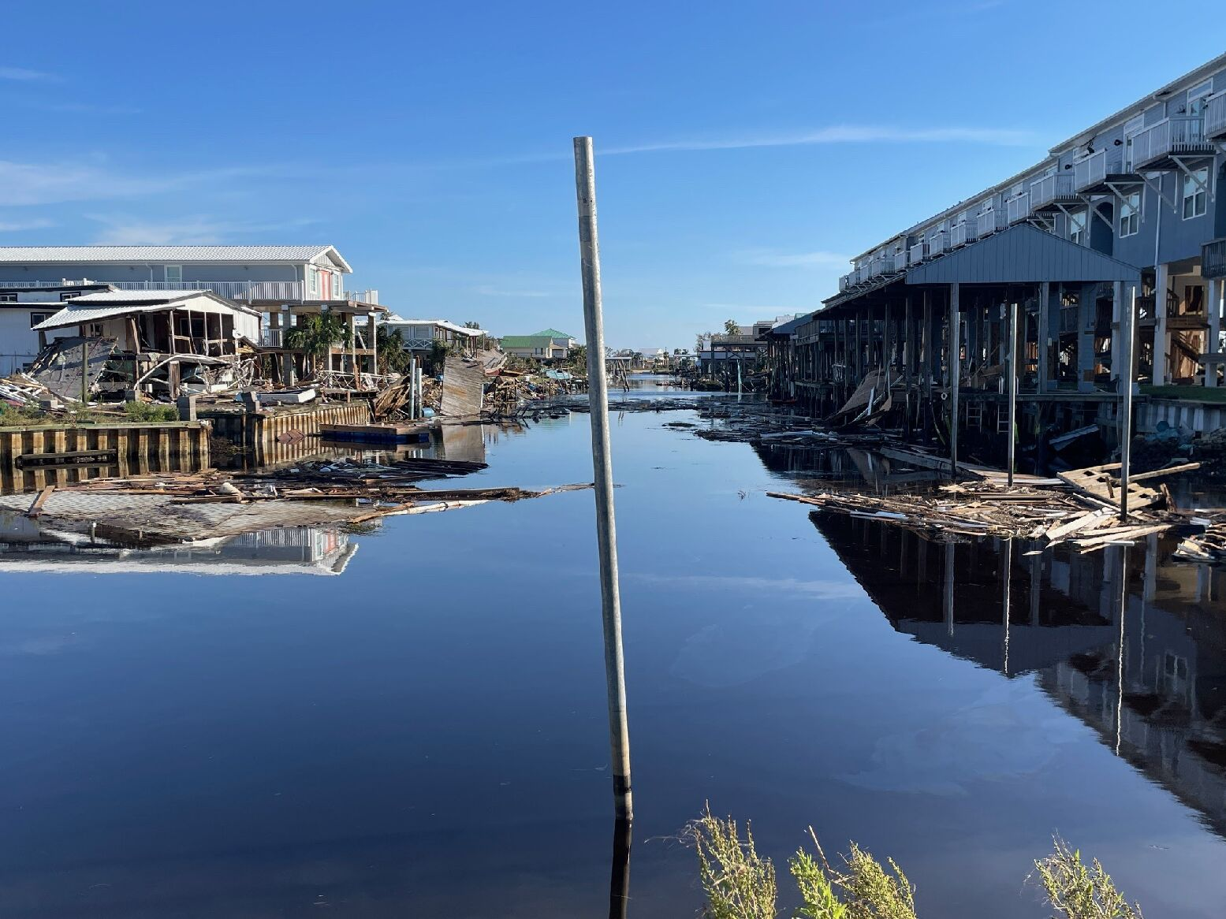
Florida

Slide 12
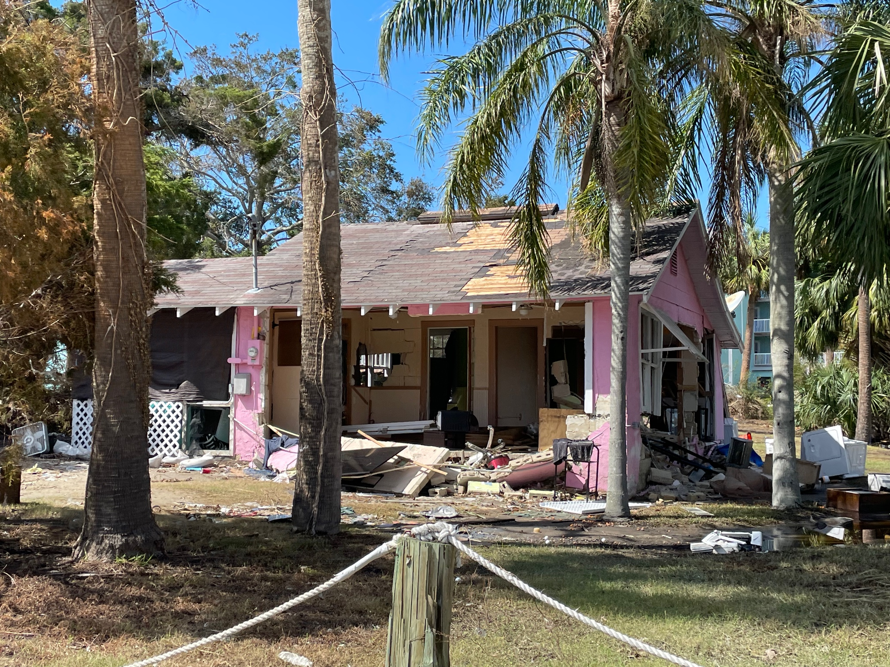
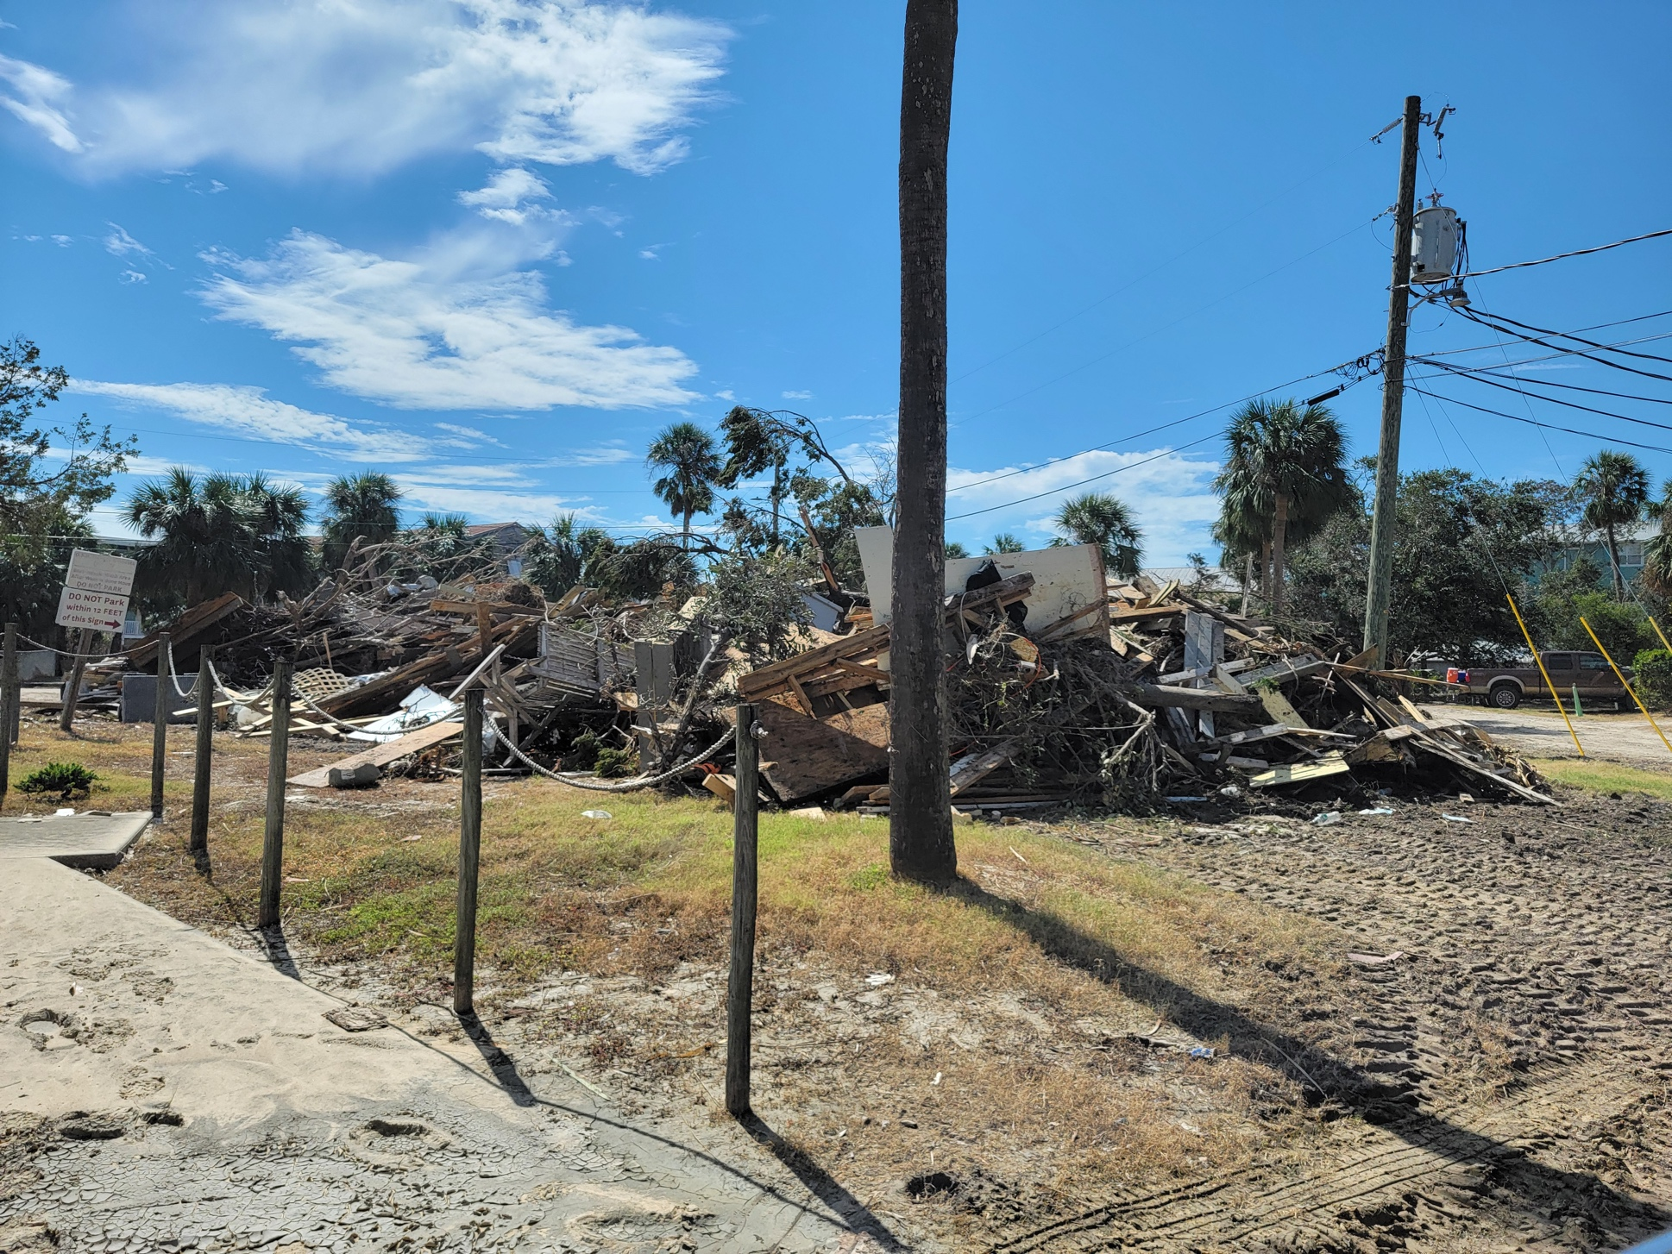
Florida

Slide 13
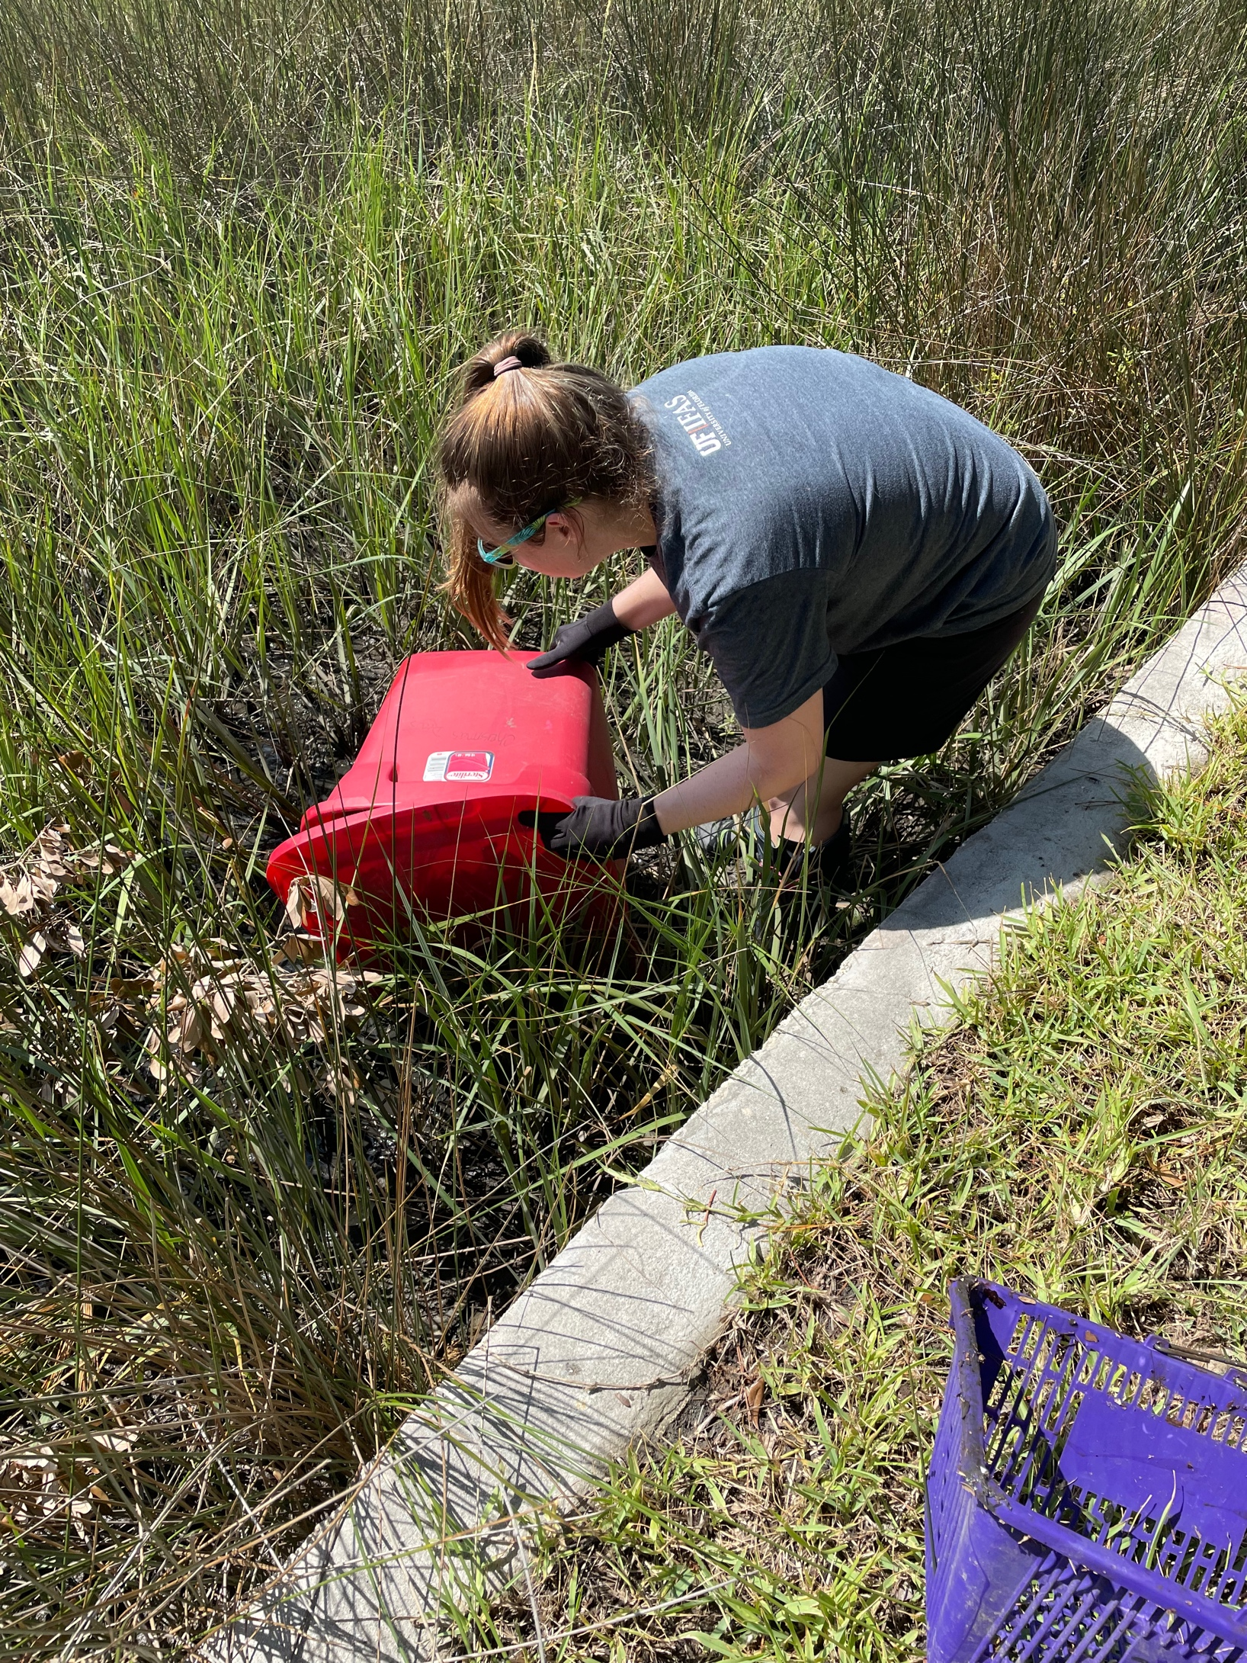
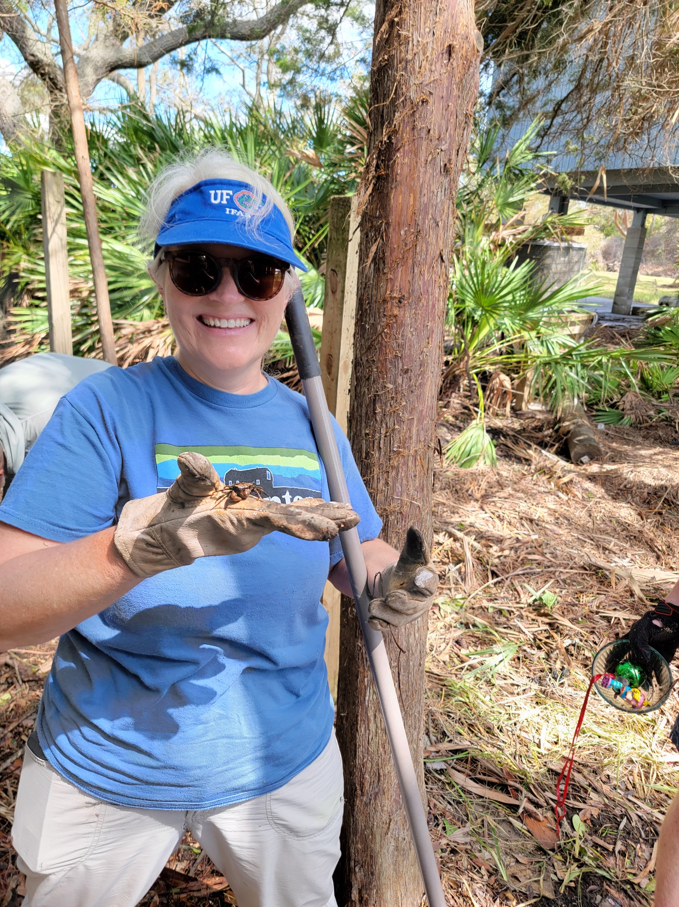
Florida

Slide 14
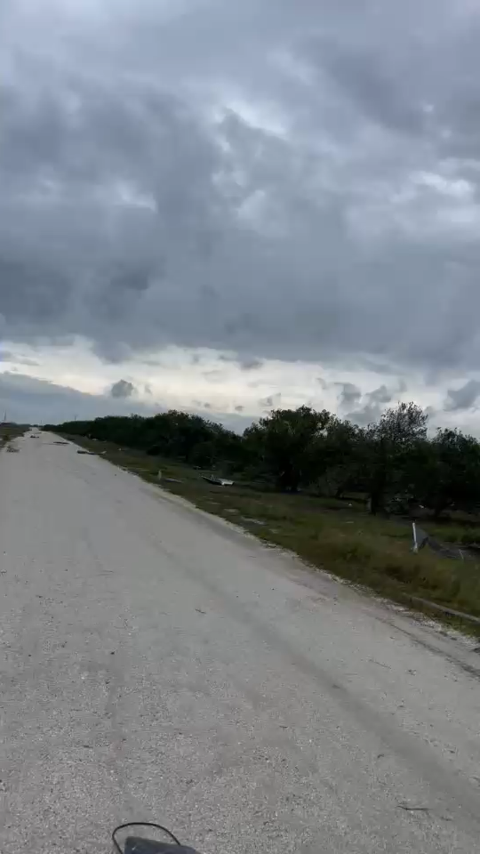
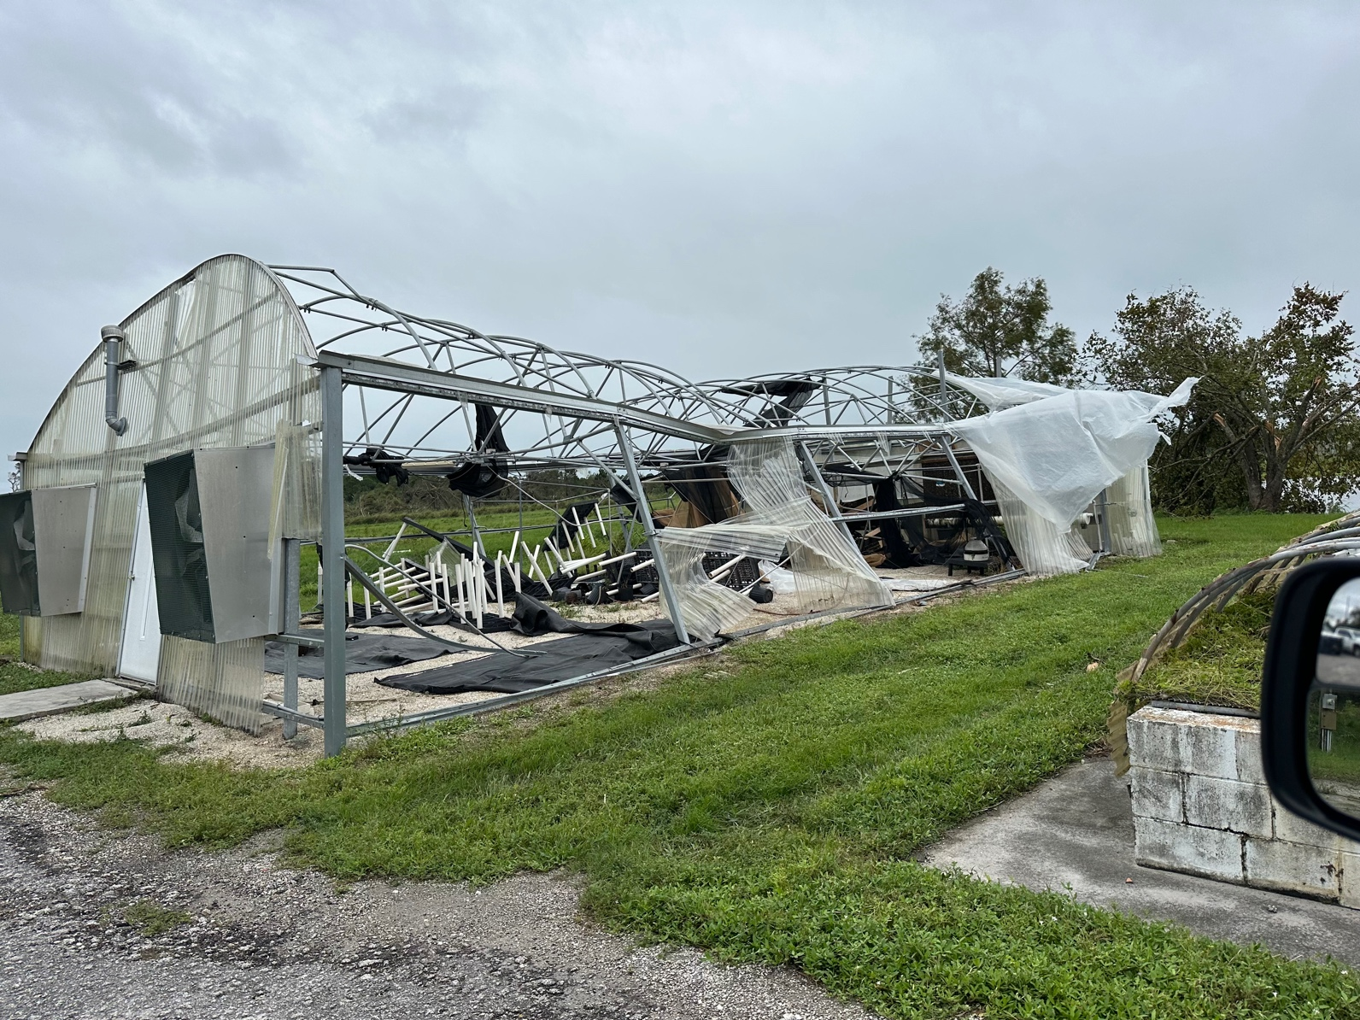
Highlands County,
Florida
Assessing Damages
Hurricane Milton

Slide 15
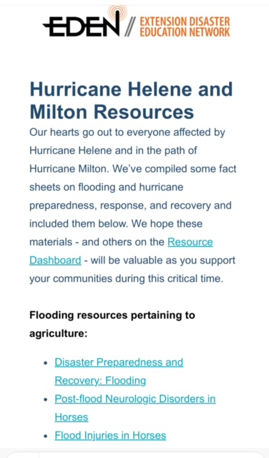
Extension Foundation
* Email blast to EDEN POCS & Delegates
* Social Media
* http://extensiondisaster.net
* Mini-grant Program
The Network
* Sharing of Information
* Sharing of Experiences
* Knowing Someone has Your Back

Slide 16

A cord of three strands is not easily broken…… King Solomon

Slide 17
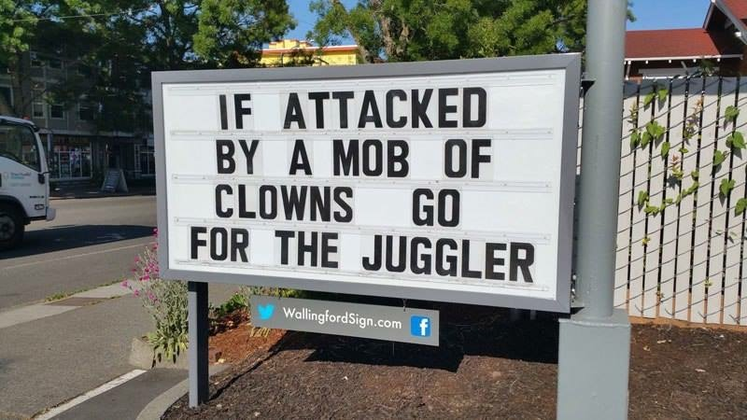
Thank you, any questions

